Slide 1
Click the Circle
Development Documentation

Slide 2
Thought Process:
The goal was to create a simple game that tested users’ reactions, similar to something like Bop It, but easily implementable through p5
The player would click on an appropriate square, which would be determined randomly and expressed via prompt
The game would also output information to an Arduino board in the form of lighting up LEDs that corresponded to the prompts on screen
There would also be music playing, possibly speeding up after a set number of points
In order to incorporate physical input, the game could be started and restarted via button press

Slide 3
Development Process:
First, I lowered my goal from 8 squares to 4 after realizing that 4 would look better on screen and that only wiring 4 LEDs would allow me to keep each color unique and color coordinated with the game on screen
I also realized that implementing various prompts would be a bit complicated to finish in time for this project, so instead, I could narrow down the prompts to only clicking on the circles
I then realized that I should incorporate another form of input, so I added the rule that if there were multiple circles on screen, the game would ask for keyboard input instead of a mouse click

Slide 4
Game Phases:
Phases determined by 2 Boolean flags: opening_screen and finished_playing
Opening_screen is true by default, shows screen with instructions and waits for button input from Arduino
Finished_playing is false by default, indicates that game is being played
Once game over is reached (wrong input or time runs out), finished_playing is changed to true and the final screen is displayed

Slide 5
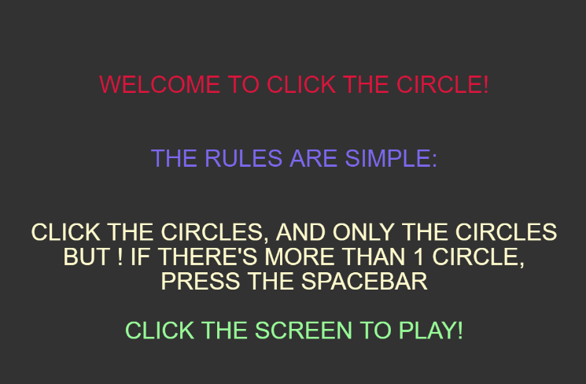
Intro Screen + Instructions

Slide 6
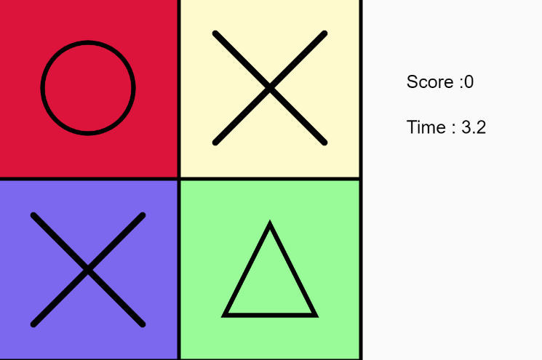
Game Screen

Slide 7
Game Screen cont.
Consists of 3 major elements: 4 Tile objects, timer, score
Score goes up on correct option selection, resets timer and scrambles tiles
Timer resets to max_time, which starts at 8 but decreases by a second every 3 points
Also, every turn, run a function to make sure there’s a circle on screen and count the number of circles (to determine whether or not a space bar input is needed)
Background music plays, goes up an octave every 10 points (only goes up 2 octaves total, since I was never able to get to 30 points myself)

Slide 8
Tile Class
Has x,y coordinates, a given color, given note, and a shape that changes upon turn
Functions include: constructor, draw, isClicked, playNote, randomShape, and drawShape
RandomShape chooses 1 of 4 shapes at random and assigns it to the tile
From pool of circle, square, triangle, and X
drawShape then draws that shape

Slide 9
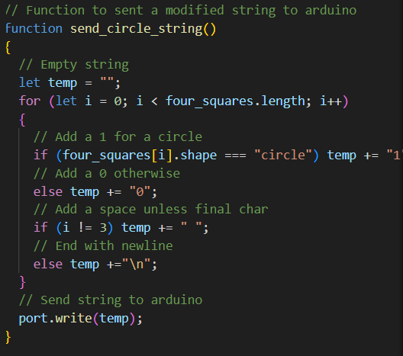

Arduino Communication
Function send_circle_string sends a message to Arduino in form “XXXX”
1 if that square is occupied by a circle
0 otherwise
Example “0100”
Arduino takes that input and lights up a corresponding LED

Slide 10
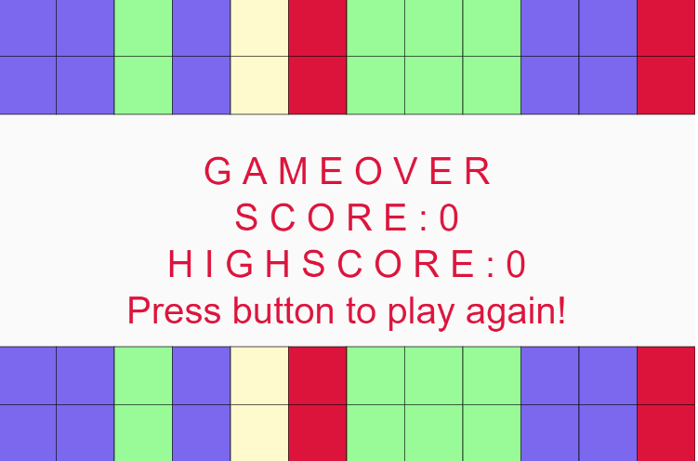
End Screen + Results

Slide 11
Thoughts on Future Dev.
First, an obvious step would be to increase the number of tiles on screen, but I think that over cluttering would actually be detrimental to the fun of the game
Instead, I think that creating a dedicated Prompt class would be a fun way to make it a bit more complicated
The class would randomly select 1 of the 4 shapes. Then, the user would have to either click on the shape or press the spacebar if there were multiple on screen
I would also have to add a global var selected_shape and modify my circle_count and find_circle methods
One of these prompts could be to ask for an Arduino button press

Slide 12
Thoughts on Future Dev. (cont.)
The other thing I could do is to implement a set of prompt rules:
For example, if there’s two of a shape, press space bar, but if there’s three of a shape, select the single shape
Or, prompts could be conveyed via the LEDs, asking the player to rely on physical input to determine what Tile to select
I worry that these would increase the complication without increasing the fun of the game, but they would be interesting to implement

